Slide 1
Lesson 6 Booleans
teaching functions to compare

Slide 2
entry procedure
A
take out your Booleans packet
enter the code for safe-left? and safe-right? into your "cage" file
B
take 2 laptops back to your group
take out your Booleans packet
enter the code for safe-left? and safe-right? into your "cage" file

Slide 3
warm up
What would Racket say to the following lines of code?
> (+ 1 4)
> (/ 4 2)
> (- 0 9)
> (* 3 4)

Slide 4
language table
Data Types | Functions
Notes:
What types of data have we worked with so far? What are some functions that work on those data types?

Slide 5
agenda
Computers out; no login
Warm Up
Review Language table
Discussion; the power of comparison, true and false
Warm Up review with more exercises
Sam - safeleft?, saferight? and onscreen?

Slide 6
true or false
True or False
Mr. Allatta is wearing a tie.
Ice is hot.
Our classroom is on the 4th floor of the Washington Irving campus.
Notes:
So far, our language can only add, subtract, multiply and divide numbers. It can't compare them or decide whether something is true or false! We'll be adding the power of comparison to our language today.

Slide 7
more booleans
how about these?
(> 0 5)
(= 1 9)
(<= 2 2)
(string=? "dog" "cat")

Slide 8
boolean contracts
 | Function Name | Domain | Range
(> 0 5)
(= 1 9)
(<= 2 2)
(string=? "dog" "cat")

Slide 9
setup your files for today's lesson
Type afsenyc.org/fda into the address bar of your web browser.
Go to Lesson Feed
Click on the "Cage File" link and save.
If that doesn't work, copy and paste the "Cage" file code into a new program in wescheme.

Slide 10
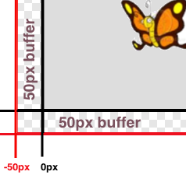
lesson 6
Sam is in a 640 x 480 yard. How far he can go to the left and right before he's out of sight?
Notes:
what data types do we know so far?
what are some functions that we know so far?
and we know how to define functions using functions in the computers language.
When Run is clicked, a window with a butterfly in it will pop up. You can use the arrow keys to move the butterfly around.
This butterfly is Sam - he’s a happy student like you! He likes to fly around outside and enjoy the fresh air.
His yard is 640 pixels wide and 480 pixels tall. If the bottom-left corner is (0, 0), what are the coordinates of the other corners?
Sam’s mom tells him that he should stay where she can see him - that means he can even step a little outside of the yard...as long as a piece of him is visible, his mom is okay.
Try moving him so he’s a little off the screen, but still safe. How far can he go?
Sometimes, however, Sam sneaks out of the box and just keeps going! He’s free! Free as a bird! (well, as a butterfly!) Look at his smile! He’s so happy to be free! Why shouldn’t he be?
Well...there’s some bad news.
Sam doesn’t realize that there’s a monster outside his yard, waiting to eat him! As long as ANY part of Sam is still in the yard, he is safe...but the moment he disappears completely his mom won’t be able to keep an eye on him!
It’s up to you to keep him safe!
Draw a 640x480 rectangle on the board to represent the screen, and have students help you identify the coordinates at the corners. Then turn students’ attention to the computers, and have them analyze the last function in the code, called onscreen?.
This file contains three function definitions. Can you find all three? What are the names of these functions?
(safe-left?, safe-right? and onscreen?)
Skit:
Have a volunteer stand up to be safe-left?. Ask them about their domain and range, and what they do according to the code (they always return true). Have students practice calling the function with sample values, then have another volunteer repeat the process as safe-right?. Finally, have a third volunteer do the same as onscreen?. Note that onscreen? must use safe-left? when evaluate an input!
The computer only talks to onscreen?, when deciding whether or not to let same keep moving. In turn, onscreen? will need to use both safe-left?and safe-right? to figure out if Sam is safe on both sides.
What are the Domain and Range of onscreen? What does the function do? What will happen when it’s given a sample input? (Answer: It calls the function ’safe-left?’ on the variable x)
We need to fix this code, to keep Sam safe. He can fly left or right and there is nothing to stop him from moving off the screen... yet!
How far can Sam go to the left before he disappears completely? (Answer: -50.) So he is onscreen as long as x is greater than -50!
Take some ideas from the class, then explain if necessary.
When the butterfly is drawn at some coordinate, it is centered at that coordinate. So if it’s drawn at 0, half of the butterfly is actually off the screen. We add the extra 50 pixels on all sides, because a piece of him is still visible as long as he is within 50 pixels of the screen’s edge.
Turn to Page 17. Take thirty seconds to fill out what we’ve discovered.
Turn to Page 18 and read the word problem for the safe-left function.
Who would like to act out safe-left? Take a volunteer.
Exercise:
According to the word problem, what’s your name? What’s your Domain? Your Range? Given Sam’s x-coordinate, and tell me if any part of him is still on the screen. Let’s try it out. "safe-left forty-five!" "safe-left three!" "safe-left negative sixty-one!" How did you know Sam was not protected at -61? because the number was not greater than -50!.
Complete the design recipe for safe-left.
Raise your hand after you complete each step.
When a team has completed the Design Recipe for safe-left, they must type in the examples and function body onto the computer.
So now we have a function that will tell us whether or not Sam is safe on the left side of the screen.
Click "Run", and try to move Sam off the left edge of the screen. Congrats! You’ve protected Sam on one side!
Unfortunately, Sam can still escape on the right hand side. We need a safe-right!
(act out with another volunteer, if necessary).
Turn to Page 19, and write another function called safe-right.
Call me over when you reach a stopping point!
Notice that even though we’ve fixed safe-right?, onscreen? won’t know about it until we change the body ofonscreen? so it calls safe-right? instead of safe-left?! Please make this change now, so that Same is safe on the right side instead of the left side.
Good job! Now we can keep Sam safe on the left side, or we can keep Sam safe on the right side. However, we don’t have a way to keep him safe on both sides! When we call onscreen? with an x-coordinate, what should it do?

Slide 11
entry procedure A day
B
take out your Booleans packet
open your game file
enter the design recipe for safe-left? into your "cage" file
A
take 2 laptops back to your group
take out your Booleans packet
open your game file
enter the design recipe for safe-left? into your "cage" file

Slide 12

estimate Sam's x coordinate
50
50
50
50
50
50
50
50
480
640

Slide 13
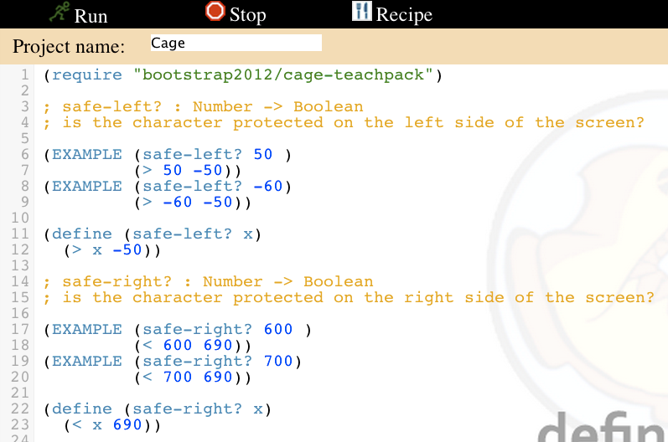
fix safe-left? and safe-right?
enter your examples
fix your definitions

Slide 14
and
or
; and: Boolean Boolean -> Boolean
; Returns true if BOTH inputs are true
; or: Boolean Boolean -> Boolean
; Returns true if EITHER of the inputs are true.
Notes:
Sugar is sweet.
Ice is hot.
Sugar is sweet and Ice is cold.
Sugar is sweet and Ice is hot. Why is it false? Isn’t sugar still sweet?
Sugar is sweet or Ice is cold.
Sugar is sweet or Ice is hot. Why is it true? Ice isn’t hot!

Slide 15
AND OR EXAMPLES
1.
Sugar is sweet.

Slide 16
2.
Ice is hot.

Slide 17
3.
Sugar is sweet and Ice is cold.

Slide 18
4.
Sugar is sweet and Ice is hot.

Slide 19
5.
Sugar is sweet and Ice is hot.

Slide 20
6.
Sugar is sweet or Ice is cold.

Slide 21
7.
Sugar is sweet or Ice is hot.

Slide 22
how to design programs?
There are two ways to go about solving this word problem:
(define (onscreen? x)
(and (> x -50) (< x 690)))
and...
(define (onscreen? x)
(and (safeleft? x) (saferight? x)))
Notes:
Does it matter? Both will work just fine when you type them in...so why care?
There’s more to being a writer than putting down grammatically-correct sentences. There’s more to being an architect or an artist than building a bridge or coloring in a canvas. All of these disciples involved an element of design.
Likewise, there is more to being a Programmer than just writing code. You've gotten decent at writing code, and now you’re able to write sophisticated programs that include multiple functions - congratulations! But that also means you’re ready to consider what it means to design the code that you write.
The first solution puts all of the logic into one function: the left boundary and the right boundary are both tested by onscreen?. In the second solution, onscreen? uses both helper functions, each of which only tests one boundary at a time. Can you think of a reason why one might be better than another? Is it better to have a single, complex function that does all the work, or to have multiple simple functions that only do one thing apiece?
Suppose you just built a car, but it’s not working right. What would you do? Ideally, you’d like to test each part of the car (the engine, the transmission, etc) one at a time, to see which one was broken. The same is true for code! If you have a bug, it’s much easier to find when every function is simple and easy to test, and the only complex functions are just built out of simpler ones.
Another reason to like the second example is the fact that it lets programmers be lazy. Suppose you have a few characters in a videogame, all of which need to be kept on the screen. Some of them might only need safe-left?, others might only need safe-right?, and only a few might need onscreen?. What happens if the game suddenly needs to run on computers with differently-sized monitors, where the boundary is 1000 instead of 690? If you have simple and complex functions spread throughout your code, you’ll need to change them all. If your complex functions just use the simpler ones, you’d only need to change them in one place!
Badly designed programs can work just fine, but they are hard to read, hard to test, and easy to screw up if things change. As you grow and develop as a programmer, you’ll need to think beyond just "making code work". It’s not good enough if it just works - as artists, we should care about whether or not code is well designed, too.
This is what functions allow us to do! Everyone from programmers to mathematicians uses functions to carve up complex problems into simpler pieces, which make it possible to design elegant solutions to difficult problems.
So the next time you sit down to solve a problem, think about algebraic abstraction, and how you might design a beautiful solution out of simple functions, rather than a huge, complex one.

